Slide 1
Capstone Project – The battle of neighborhoods
Johnnie Ng

Slide 2
Introduction
Background: For Chinese people who are new to Toronto, how do they know what the best Chinese Restaurants are worth going to and where they are?
Problem: This project aims to create a simple Chinese Restaurants Guide based on Foursquare Rating, restaurant category and geographic location data for restaurants in Toronto. Finally, these restaurants will be clustered based on their similarities.
Interest: Chinese people who are considering to visit Toronto will be interested to explore Chinese Restaurants to get something to eat.

Slide 3
Data Acquisition and Cleaning
Scrape the following Wikipedia page, https://en.wikipedia.org/wiki/List_of_postal_codes_of_Canada:_M, in order to obtain the data that is in the table of postal codes and to transform the data into a pandas dataframe.
Get geolocator latitude and longitude coordinates for Toronto.
Use Foursquare API to get a list of venues in Toronto.
Use Foursquare API to get restaurant name, ID, location, category and rating.

Slide 4
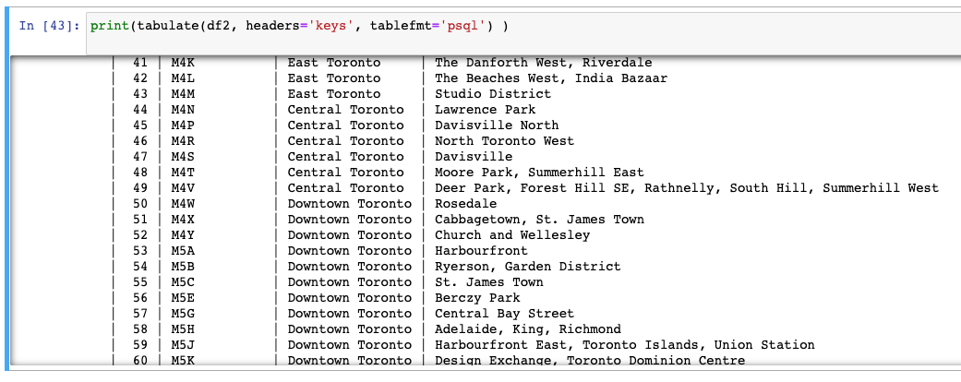
Methodology
Use Beautiful Soup library in python to scrape the Wikipedia page to extract the data in the tabular format as shown in the website.

Slide 5
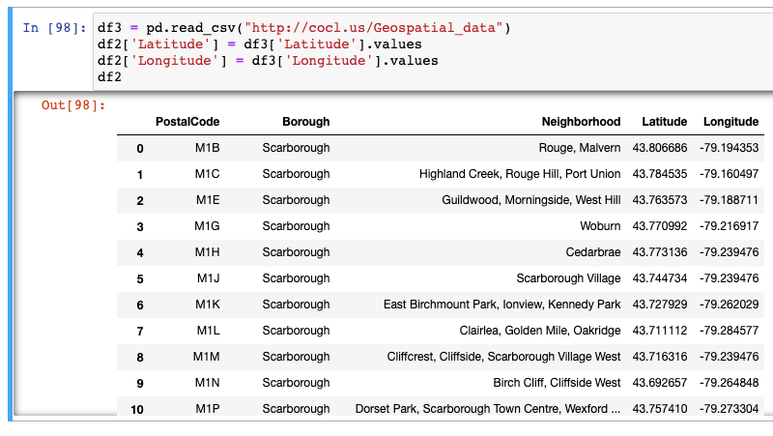
Methodology
Use the csv file to create the dataframe with Latitude and Longitude and Merge two data sets on the Postal Code to form a new data set for visualization.

Slide 6
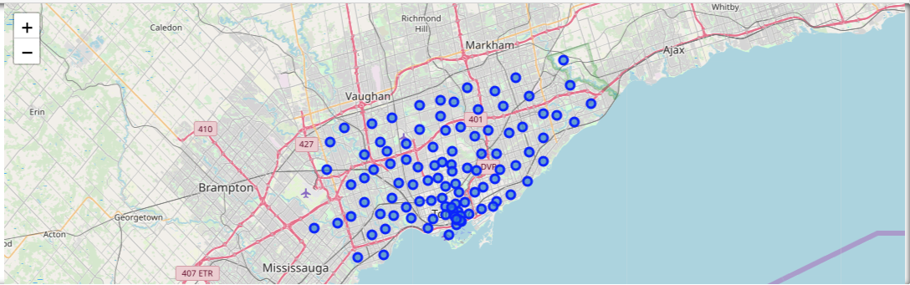
Methodology
Use geopy library to get the latitude and longitude values of Toronto and create a map of Toronto with neighborhoods superimposed on top.

Slide 7
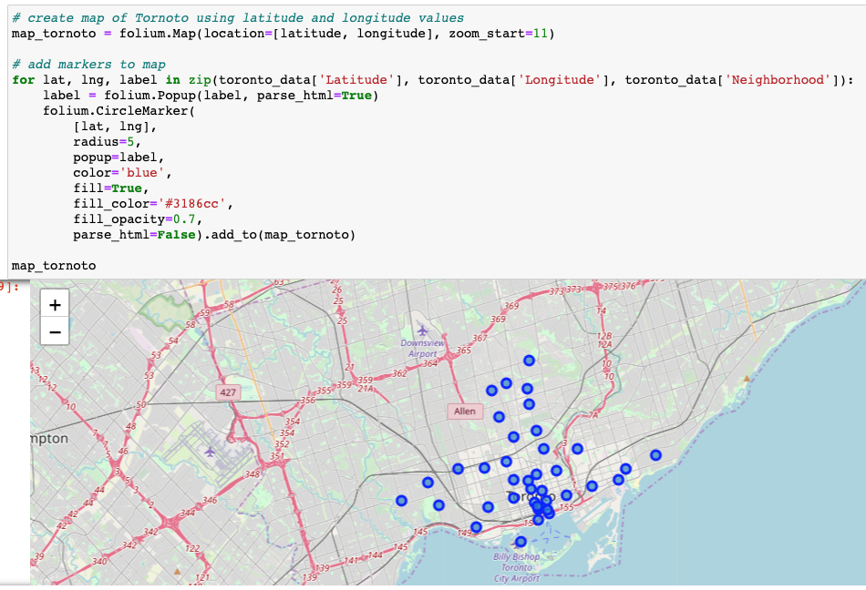
Methodology
Work with only boroughs that contain the word Toronto.

Slide 8
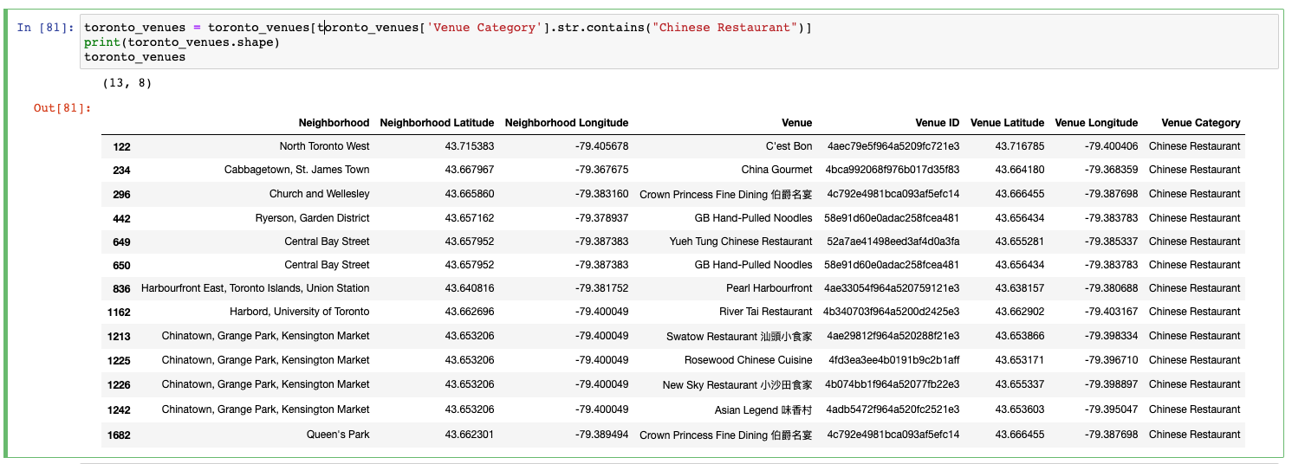
Methodology
Use Foursquare API to explore all Chinese Restaurants in Toronto with radius = 500.

Slide 9
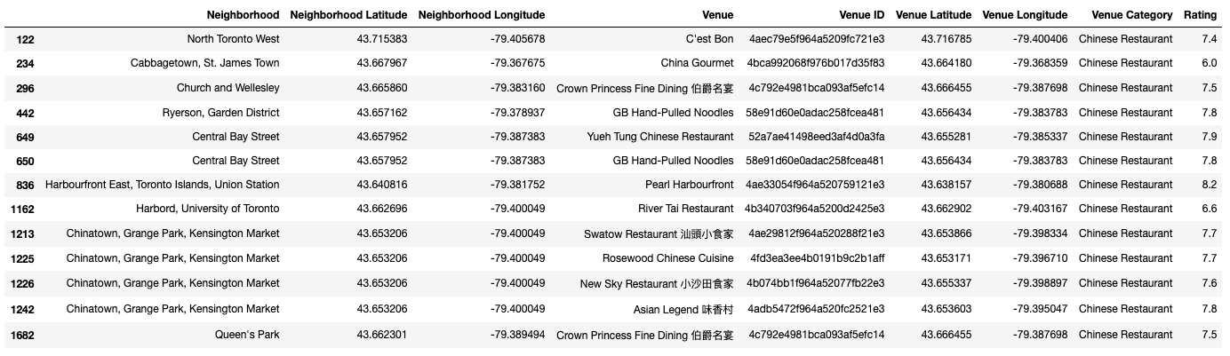
Methodology
Use Foursquare API to get rating of Chinese Restaurants based on venue id.

Slide 10
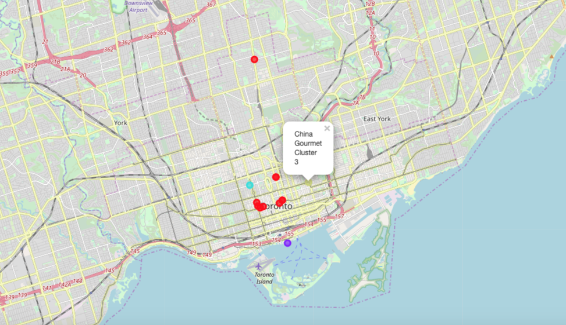
Methodology
Use k-means clustering algorithm that groups Chinese Restaurants into 4 clusters.

Slide 11
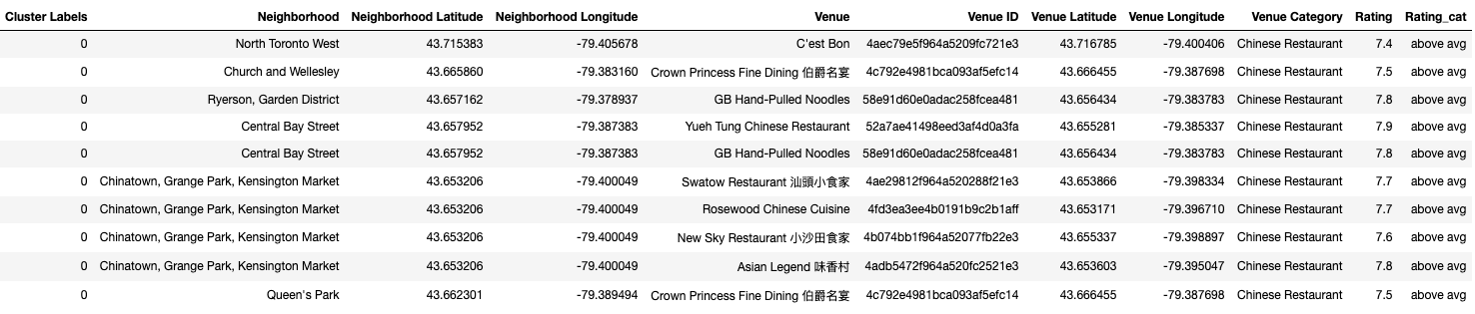
Results
Cluster 1

Slide 12
Results
Cluster 2

Slide 13
Results
Cluster 3

Slide 14
Results
Cluster 4

Slide 15
Discussion
The aim of this project is to help people who want to visit Toronto and choose the Chinese restaurants based on the rating recommended in Foursquare.
For example, if a person is looking for a Chinese restaurant with good rating, we can see that Cluster 1 and 2 have rating above 7.4.
If a person is looking for a Chinese restaurant with the highest rating, the Chinese restaurant in the second cluster is suitable.
For budget consideration, Chinese restaurants in Cluster 3 and 4 are more suitable and the rating is around 6.0.
The preference of Chinese restaurants may vary from person to person, they can select a restaurant based on their own tastes and the proximity.

Slide 16
Conclusion
This project helps a person get a better understanding of a specific type of restaurants in one area. It is always helpful to make use of technology to stay one step ahead, i.e. finding out more about rating before choosing the place to eat.
We have just taken rating as a primary concern to shortlist the best Chinese restaurant in Toronto. The future of this project includes taking other factors such as pricing and number of likes into consideration to filter restaurants based on a predefined budget and other comments.

